Slide 1
Metabolomics data analysis

Slide 2
Overarching goal
Identify putative metabolites or group of metabolites that is related to IBD

Slide 3
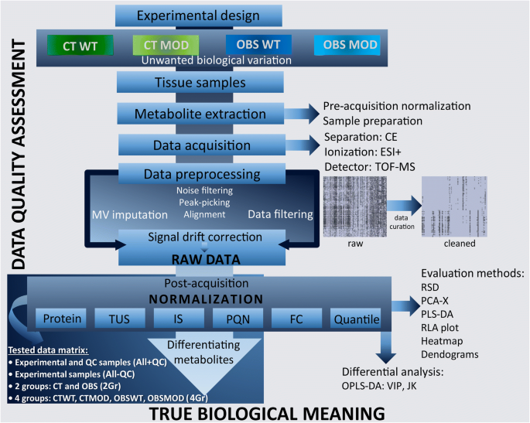
Notes:
https://link.springer.com/article/10.1007/s00216-020-02594-9
Data-dependent normalization strategies for untargeted metabolomics—a case study

Slide 4
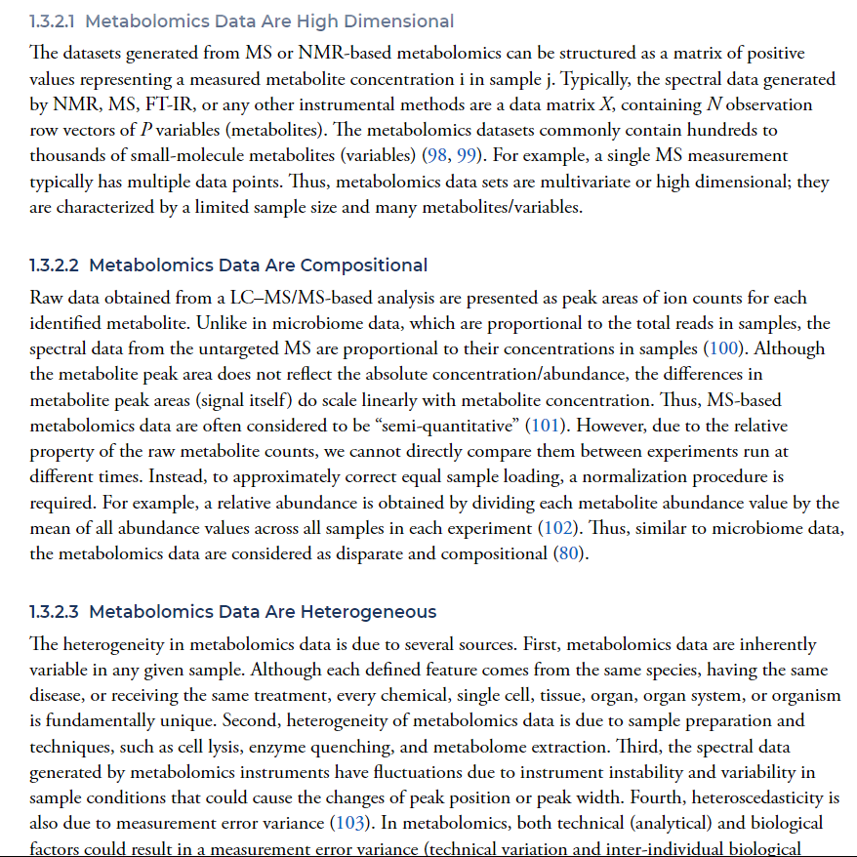
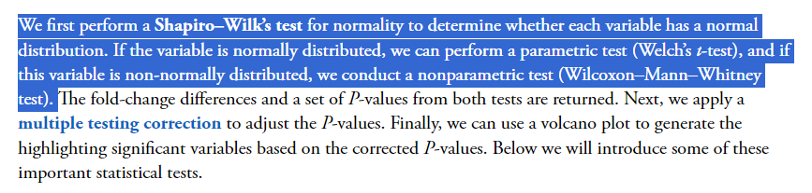
Notes:
https://link.springer.com/article/10.1007/s00216-020-02594-9
Data-dependent normalization strategies for untargeted metabolomics—a case study

Slide 5
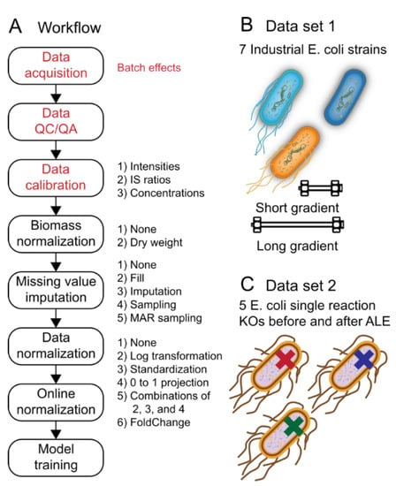
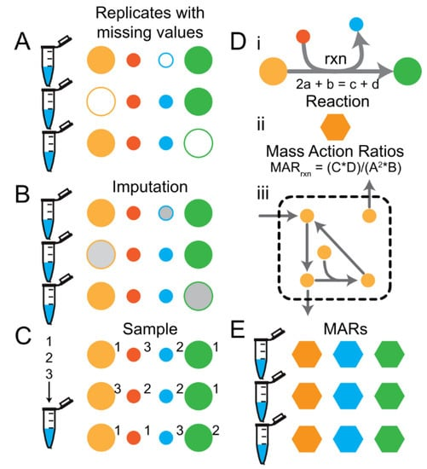
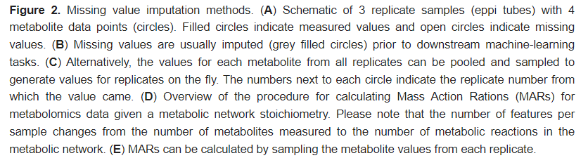
Data QC/filtering
A Comprehensive Evaluation of Metabolomics Data Preprocessing Methods for Deep Learning
https://www.mdpi.com/2218-1989/12/3/202

Slide 6
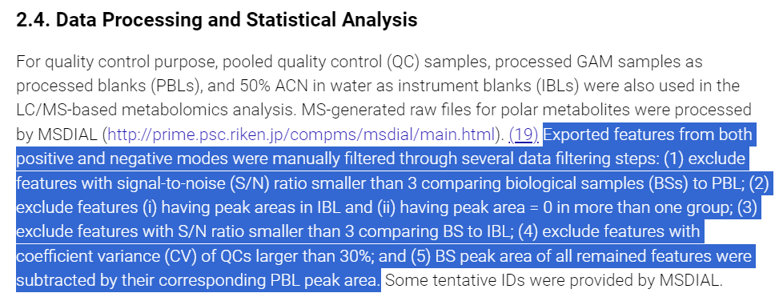
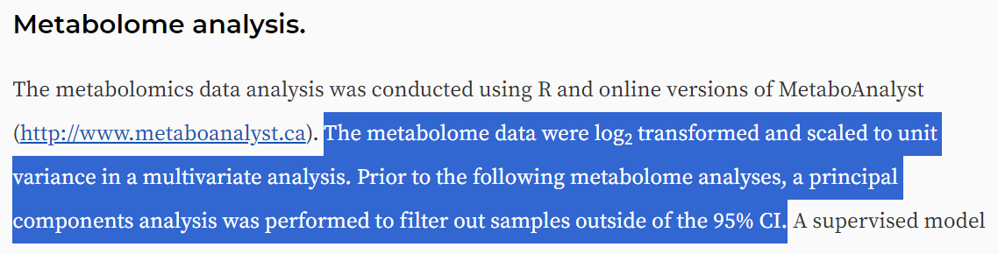
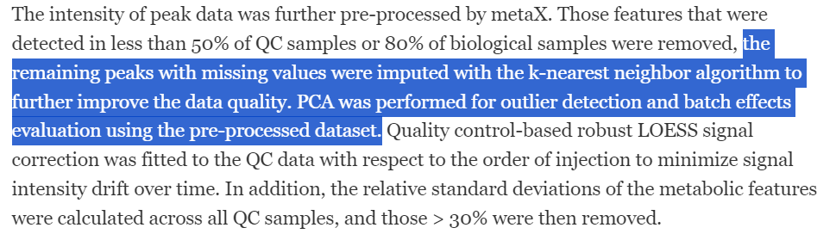
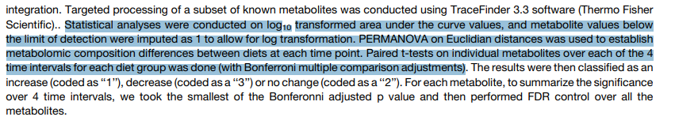
Data QC/filtering
Untargeted Metabolomics Sensitively Differentiates Gut Bacterial Species
https://pubs.acs.org/doi/10.1021/acsomega.1c07114
Identifying the Novel Gut Microbial Metabolite Contributing to Metabolic Syndrome in Children
https://journals.asm.org/doi/10.1128/spectrum.03771-22
Xylitol enhances synthesis of propionate in the colon via cross-feeding of gut microbiota
https://microbiomejournal.biomedcentral.com/articles/10.1186/s40168-021-01029-6#Sec13

Slide 7
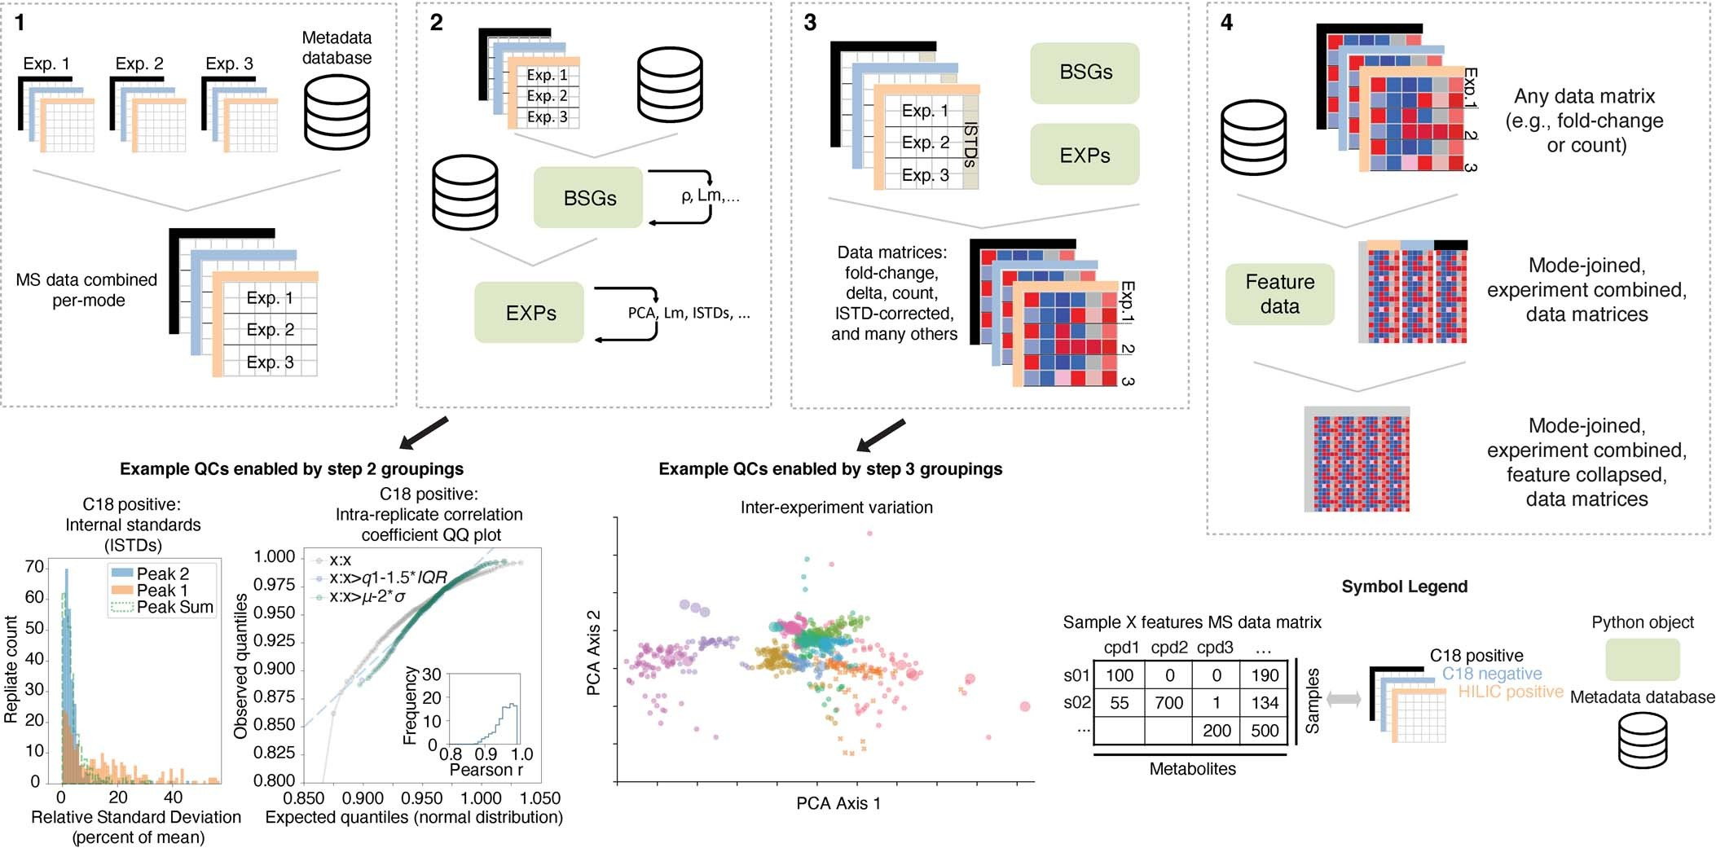
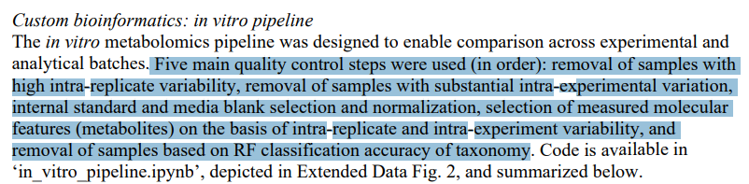
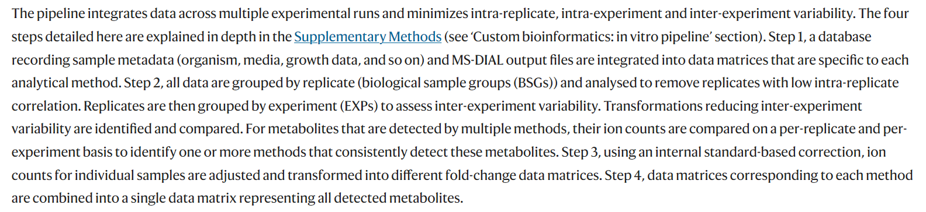
Data QC/filtering
A metabolomics pipeline for the mechanistic interrogation of the gut microbiome
https://www.nature.com/articles/s41586-021-03707-9#Sec7

Slide 8
Imputation
To do:
Make histogram of % missing-from-samples-feature to determine the distribution of feature ‘missingness’
From raw data, determine if certain features are missing associated with donor type or it is completely random
Determine appropriate imputation method

Slide 9
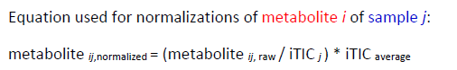
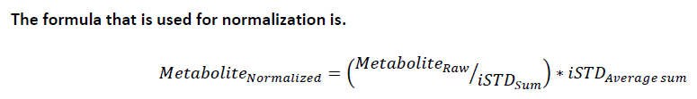
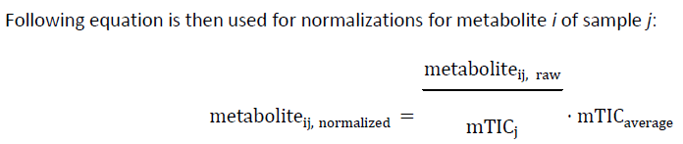
Normalization?
Biogenic Amines
Lipidomics
GCMS

Slide 10
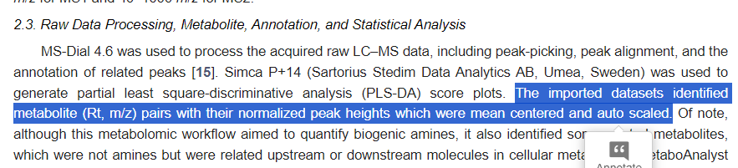
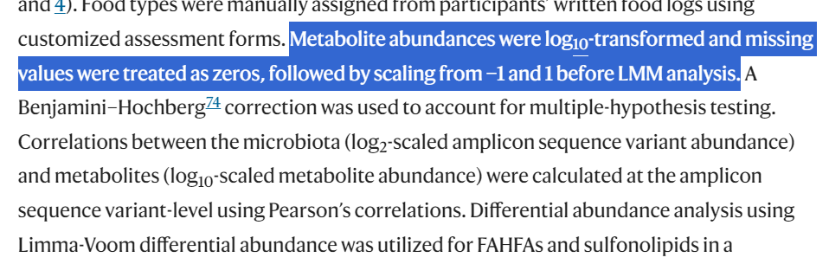
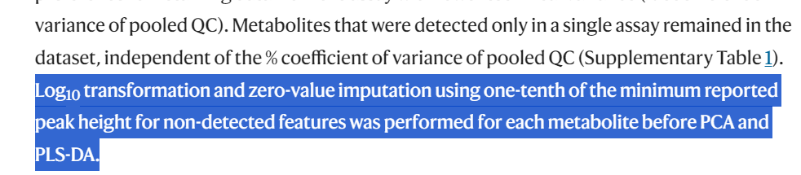
Normalization?
Notes:
https://www.mdpi.com/2227-9059/11/8/2261
https://www.nature.com/articles/s42255-023-00777-z#Sec2

Slide 11
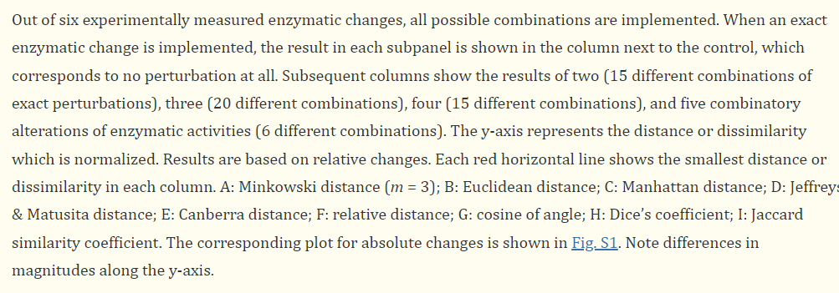
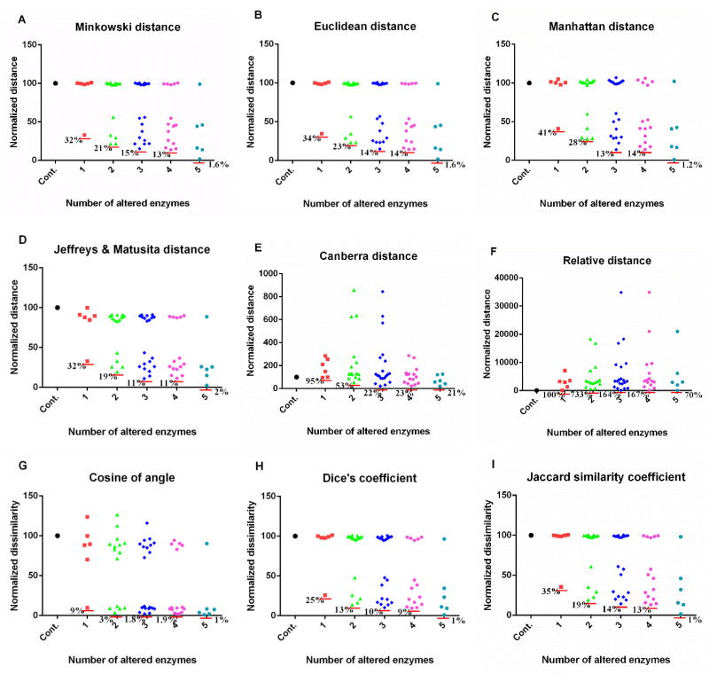
Distance Matrix?
We showed here that several metrics, including the Euclidean distance, perform well, while others do not. Six metrics (Minkowski distance, Euclidean distance, Manhattan distance, Jeffreys & Matusita distance, Dice’s coefficient, Jaccard similarity coefficient) perform similarly well, whereas three metrics (Canberra distance, relative distance, and cosine of angle) seem inappropriate for the inference of biochemical mechanisms from metabolomics data. (Qi & Voit, 2016)

Slide 12
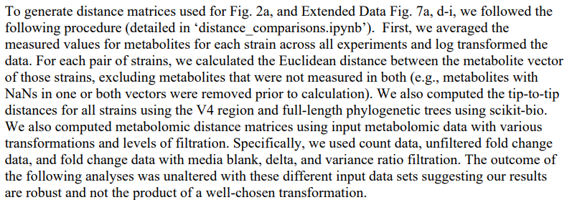
Distance Matrix?
https://www.nature.com/articles/s41586-021-03707-9#Sec7 (Fischbach Lab)

Slide 13
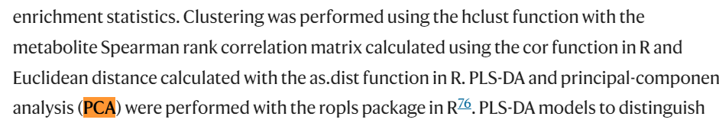
Distance Matrix?
Notes:
https://www.nature.com/articles/s42255-023-00777-z#Sec2

Slide 14
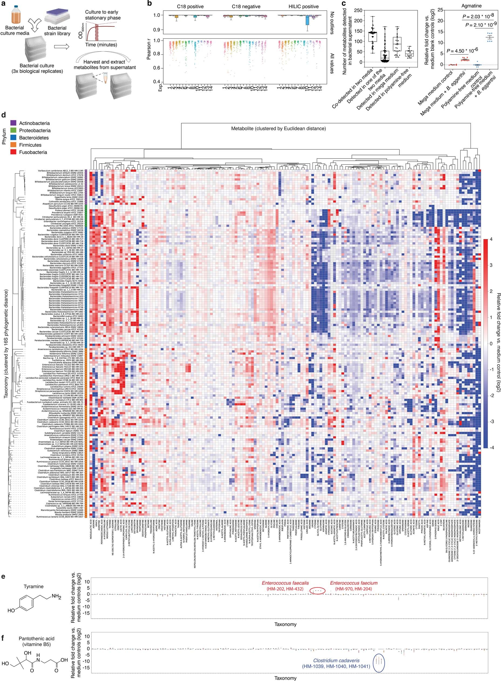
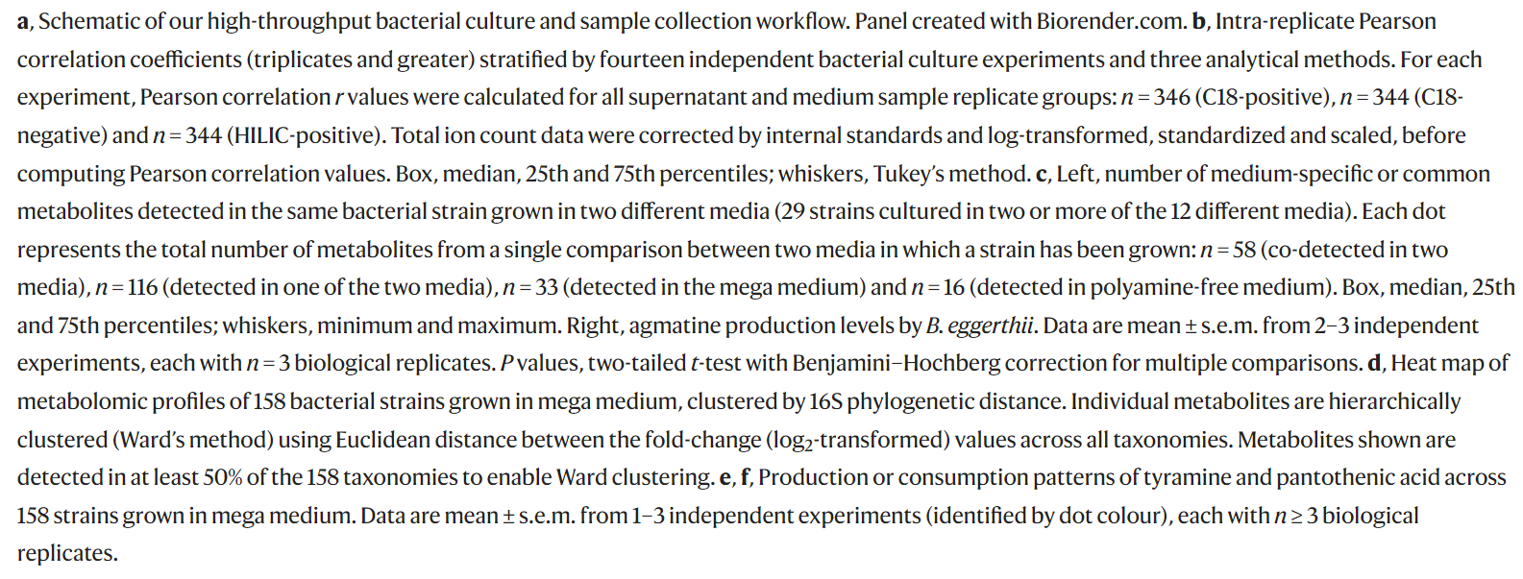
Fig Ideas
Notes:
https://www.nature.com/articles/s41586-021-03707-9#Sec7 (Fischbach Lab)

Slide 15
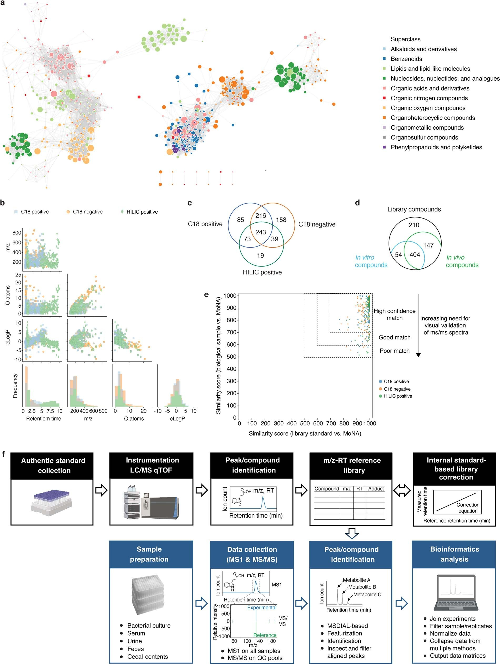
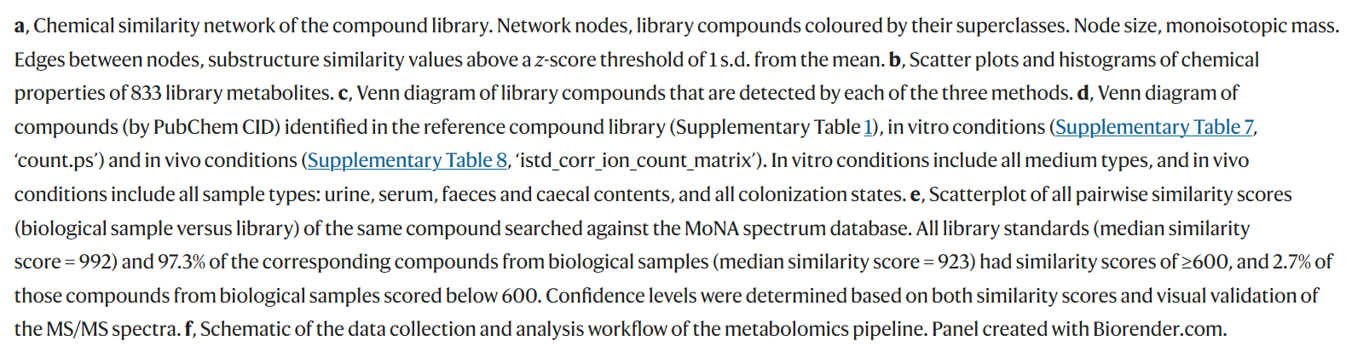
Fig Ideas
Notes:
https://www.nature.com/articles/s41586-021-03707-9#Sec7 (Fischbach Lab)

Slide 16
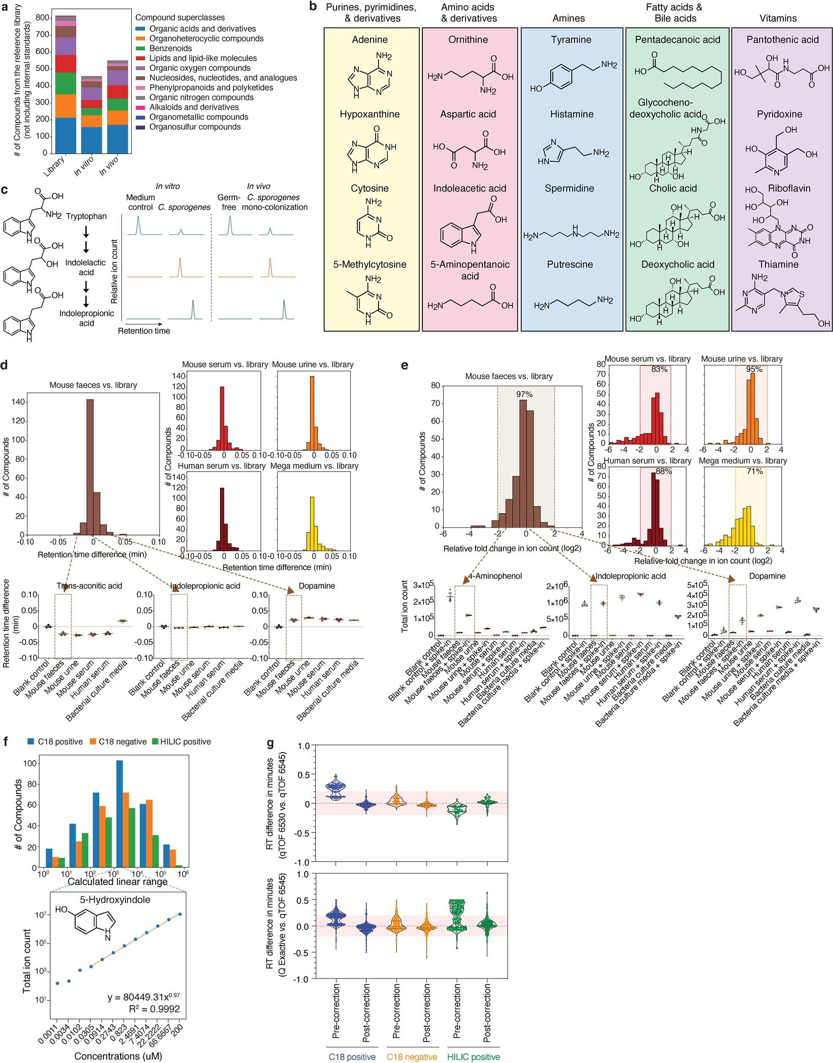
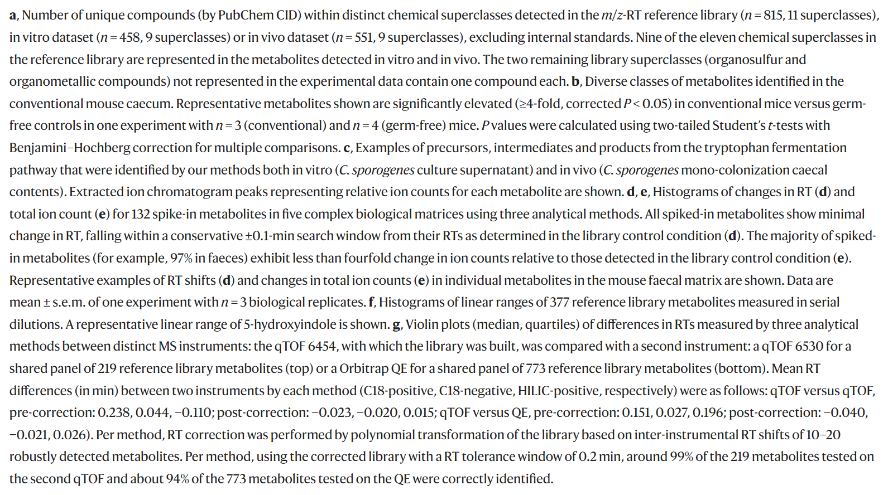
Fig Ideas
Notes:
https://www.nature.com/articles/s41586-021-03707-9#Sec7 (Fischbach Lab)

Slide 17
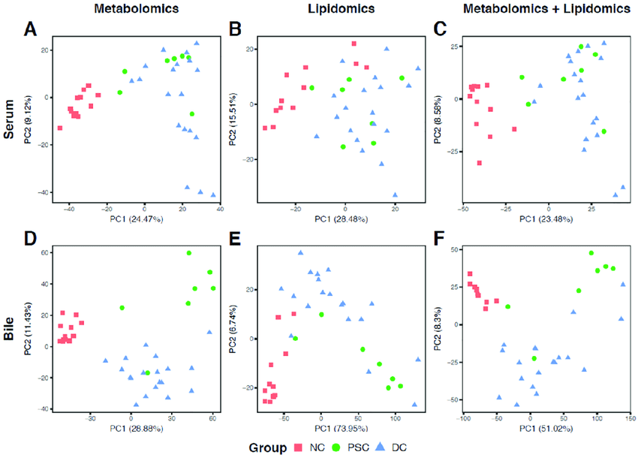
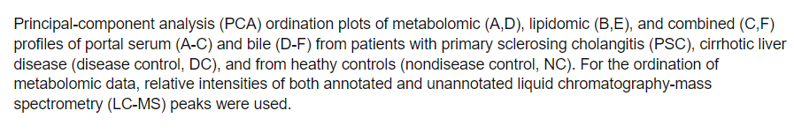
Fig Ideas
Notes:
Metabolomic Profiling of Portal Blood and Bile Reveals Metabolic Signatures of Primary Sclerosing Cholangitis

Slide 18
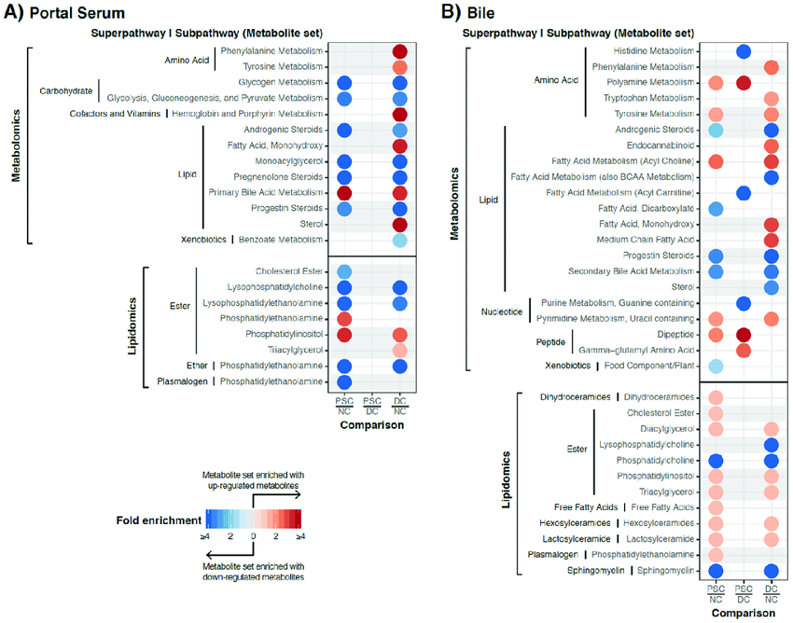
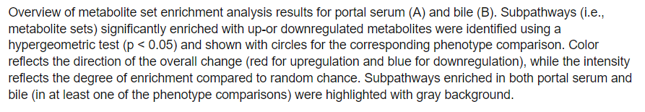
Fig Ideas
Notes:
Metabolomic Profiling of Portal Blood and Bile Reveals Metabolic Signatures of Primary Sclerosing Cholangitis

Slide 19
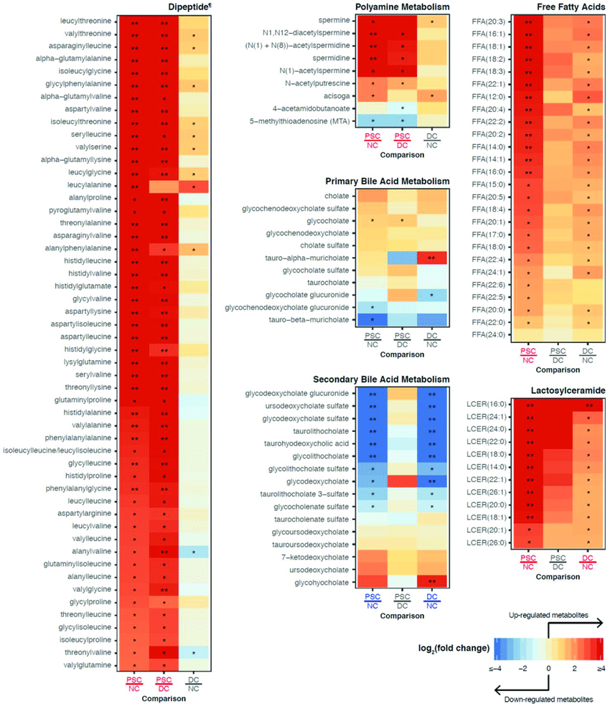
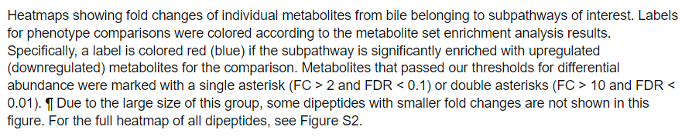
Fig Ideas
Notes:
Metabolomic Profiling of Portal Blood and Bile Reveals Metabolic Signatures of Primary Sclerosing Cholangitis

